Slide 1
Stock Forecasting
Using Long short-term Memory (LSTM) and Recurrent Neural Network (RNN) Model.
By:-
IT SEC-C 5th SEM
Radhika Saini , 1802913124 Saksham Garg , 1802913144
Sanyam Jain , 1802913147

Slide 2
Introduction
● A stock market is a public market for the trading of company stock.
● Stock market allows us to buy and sell units of stocks (ownership) of a company.
● If the company’s profits go up,then we own some of the profits and if they go down, then we lose profits with them.

Slide 3
Objective
● To accurately predict the future closing value of a given stock across a given period of time in the future.
● Use different machine learning and deep learning models available and compare them to get more accurate prediction of the model.

Slide 4
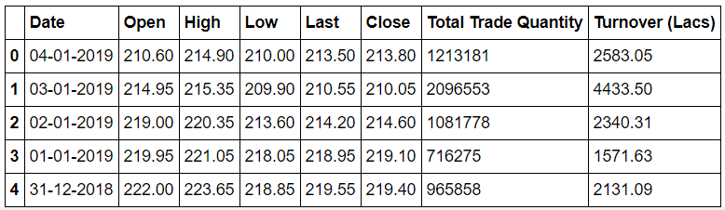
Dataset
The dataset used in this project is of the Tata Global Beverages Limited from Quandl.This is a series of data points indexed in time series.
from

Slide 5
Flow Process/Steps
Imports Libraries
Read the dataset
Analyze the closing prices from dataframe
Sort the dataset on date time and filter “Date” and “Close” columns
Normalize the new filtered dataset
Build and train the LSTM model
Take a sample of a dataset to make stock price predictions using the LSTM model
Save the LSTM model
Visualize the predicted stock costs with actual stock costs

Slide 6
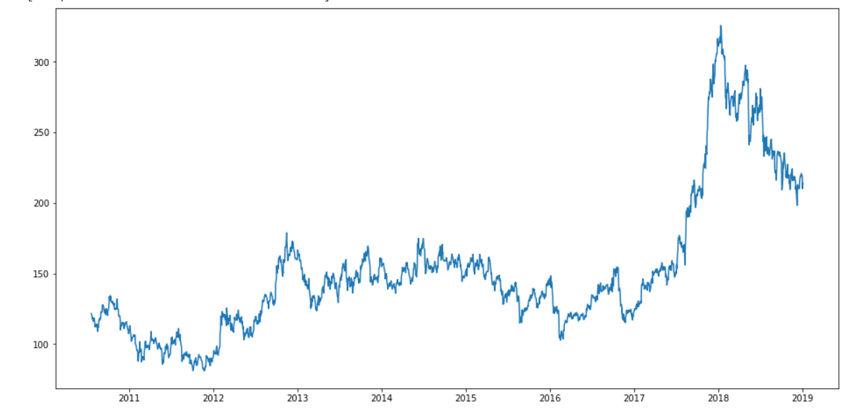
Actual Closing prices from dataset

Slide 7
Models used
● Long Short-Term Memory (LSTM) and
● Recurrent Neural Network (RNN) Model

Slide 8
Long Short-Term Memory (LSTM)
LSTMs are widely used for sequence prediction problems and have proven to be extremely effective. The reason they work so well is because LSTM is able to store past information that is important, and forget the information that is not. LSTM has three gates:
The input gate: The input gate adds information to the cell state
The forget gate: It removes the information that is no longer required by the model
The output gate: Output Gate at LSTM selects the information to be shown as output

Slide 9
Recurrent Neural Network (RNN)
A Recurrent Neural Network (RNN) is a multi-layer neural network, used to analyze sequential input, such as text, speech or videos, for classification and prediction purposes. RNNs work by evaluating sections of an input in comparison with the sections both before and after the section being classified through the use of weighted memory and feedback loops. RNNs are useful because they are not limited by the length of an input and can use temporal context to better predict meaning.

Slide 10
RNN
In a simple RNN, each input is evaluated on a single layer and an output is given. This can occur on a one-to-one, one-to-many, many-to-one or many-to-many input to output basis.
As the RNN analyzes the sequential features of the input, an output is returned to the analysis step in a feedback loop, allowing the current feature to be analyzed in the context of the previous features. Since each step requires feedback from the previous step, RNNs are unable to take advantage of Massive Parallel Processing (MPP) as CNNs can.
When an RNN is trained, it is taught what weight to assign to each input feature, which then determines what information is passed back to the feedback loop according to gradient descent. This process, which creates the “short-term memory” of an RNN, is known as Backpropagation Through Time (BPTT).

Slide 11
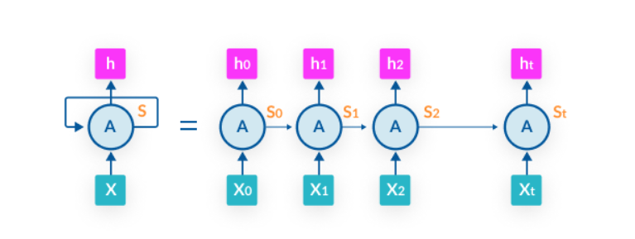
Illustration of RNN architecture feedback loop
RNNs are currently being applied to several applications, including:
Temporal analysis—time-series anomaly detection and time-series prediction
Computer vision—Image description, video tagging and video analysis
NLP—Sentiment analysis, speech recognition, language modeling, machine translation and text generation

Slide 12
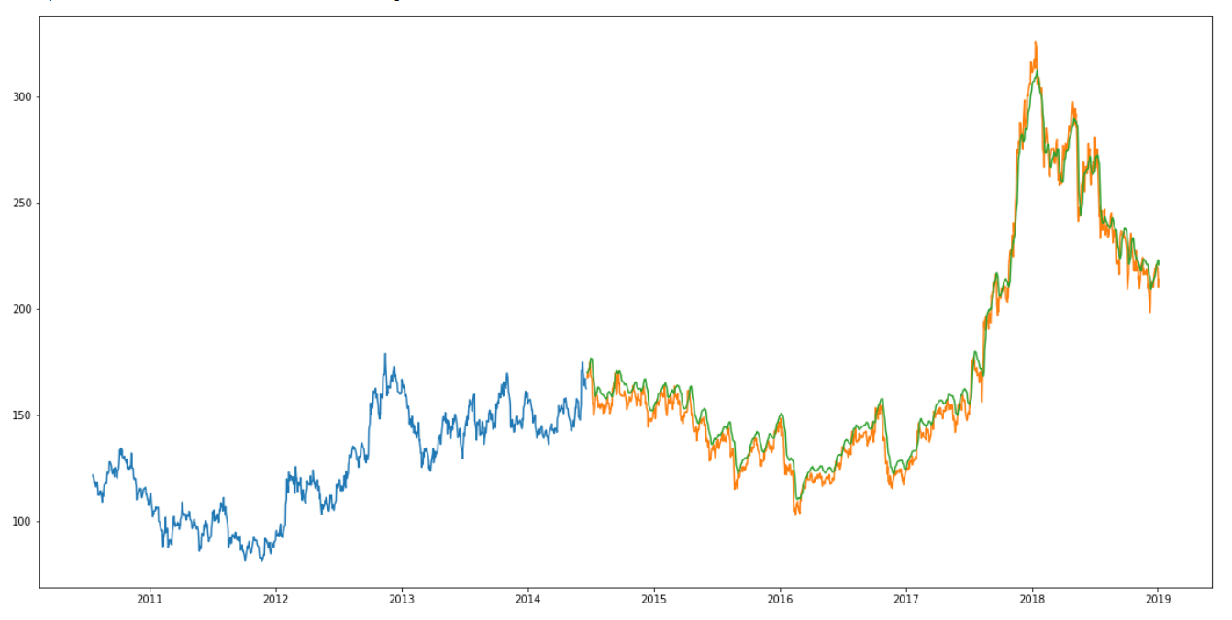
Experimental Results
● Model Fits Properly

Slide 13
Conclusion
Stock price prediction is a complex problem.
Machine Learning model does not worked well as compared to Deep Learning model .

Slide 14
THANKYOU

